Slide 1
Event Processing without Breaking Production

Slide 2

Notes:
You look around at your system and there are events everywhere. You know they are there. Some you capture some you dont. But if you could the things you could do with them.

Slide 3

Notes:
And you start to think about all the things you could possibly do with event data like that.
Machine Learning, Deeper data analytics, Auditing, Triaging issues, the list goes on and on.

Slide 4

Notes:
But then you look at production
And this is what you see
How could you possibly pull that data and those events out of that? Youve been burned plenty of times.
Let me tell you my friends it is possible.
My name is Nathan Zender and I’m going to tell you a story how we did just that

Slide 5


Nathan Zender
Developer for over a decade
Currently Tech Lead with
OSS Contributor to Micronaut and Sonatype
Cars and family
Notes:
This is me (and my beautiful wife)
I’ve been a developer for over a decade now. Tried my hand at insurance, banking, a startup building a distrubuted database and now health care with Fuse.
In my free time I like to contribute back to open source software and have been playing with Micronaut and a few Sonatype projects lately.
And when im not coding I like to drive my cars around corners quickly :) and spend time with my wife and my 2 kids.
So enough about me……..In this talk we will discuss
What we did to make this a reality
The architecture
The tools
And some painpoints that we hit while implementing this solution

Slide 6
What are we trying to solve for?

Slide 7
The problems
Inaccurate reporting due to missing data
Want to provide deeper insights and analytics
Cannot impact production performance
Split the monolith
Notes:
Due to the nature of a transactional database you generally only will keep current state of the system since keeping all changes is extra overhead and if not done correctly will in fact slow down queries for most usecases and in a transactional system not necessary for day in and day out activities.
But this can lead to inaccurate reporting if what you actually care about/need are the event changes as things happen in the system .
Great example in our case is scheduling of a service.
When a service is schedule, rescheudled or removed all of those state changes would not be tracked. We would only know end state. Well in our case this scheduling is tied to a usecase of the service only being eligible for a single pharmacy so since we could not track that we could not accurately tell you when a service was in fact eligible for your pharmacy to work.
Splitting of the monolith.
As we move into splitting out the giant application and database into more distinct products owned by teams we will need a way to communicate between them.
We plan on using an event based method to do so and using this infrastructure it leads itself to allowing us to craft those messages even before they are real and backed by a new codebase.

Slide 8
Architecture

Slide 9
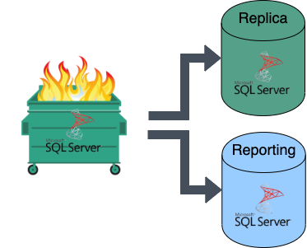
Notes:
This is the architecture
Briefly touch on each piece and here and that we will explore each one in a little more detail throughout the talk
Main transactional sql server that the application uses, the batch jobs use, the adhoc reporting team use, Joe smo adhoc query executor uses.
A replica that is setup as failover
A different reporting sql server instance that is also used by the adhoc reporting team.
In the state at we we started down building this infrastructure we had many performance problem on many different fronts.
Simply just users. Pesky users. Someone could execute a report and bring the database server to its knees.
Or same goes for the adhoc reporting case, a query would need to be executed against either the main sql server or the replica or even across all three some times and those queries could bring down the whole system.
You would think that maybe just stop using the main system and use the replica. The way our replication is setup for failover for that server it was synchronous at the time so you could write a query bad enough on the replica that would slow replication down and it would hang on the master node until it could commit on the replica.
ETL process we had in place to get data over to this reporting database where inefficient and would need to run during the day and those caused impacts.
Felt like death by a 1000 paper cuts.
Lets take a minute to discuss the Dumpster Fire in the Room.
No hate directed towards SQL Server or anything this could have been any other kinds of Dumpster Fire (postgres, mysql, anything really)
In our case it was not just that SQL Server suffered but it was our monolith that made issues for us, ad hoc queries that would dump sql server page life on us in the middle of the day and impact production, it was nightly batch jobs that pegged the server for hours or indexing/maintenance jobs that would also need to be run to keep things stable-ish.
At the time of implementing this infrastructure it was an unstable base that we were working on fixing in a parallel channel but we will needed to move forward and get something in place to provide business value.

Slide 10
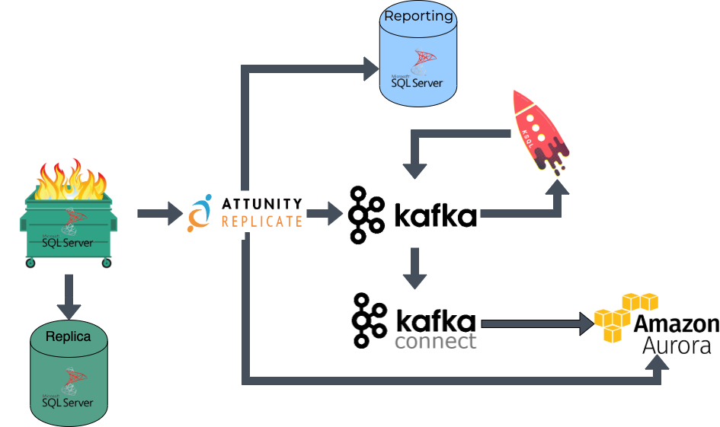
Notes:
This is the architecture
Briefly touch on each piece and here and that we will explore each one in a little more detail throughout the talk
This seems really complicated why not just use a read replica in sql server and some triggers.

Slide 11
Attunity Replicate

Slide 12
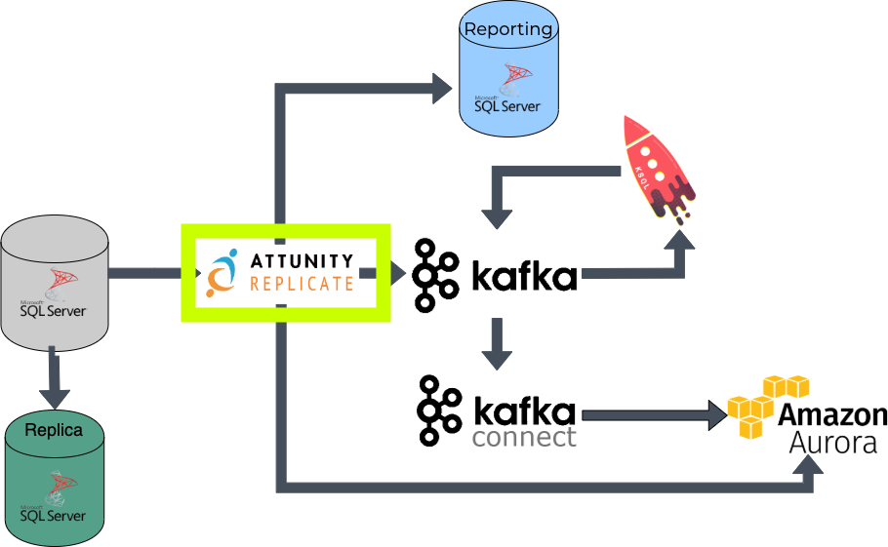

Slide 13
What is it?
Attunity Replicate provides a unified platform to replicate, synchronize, distribute, consolidate, and ingest data across all major databases, data warehouses and Hadoop, both on-premise and in the cloud.

Slide 14
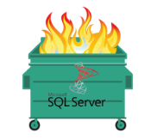
Why?
Extremely low impact to said
Ease of use/maintenance
Supports tons of sources and targets (RDBMS, NoSQL, File, etc, etc)
Notes:
One of the biggest selling points was the low impact that it would cause to production.
Spinning up a task in Attunity is very easy via the UI, and eventually we built out a way to store the task configuration of what the source/target and tables in question were in source control and deploy those our to Attunity via our CI pipeline.
The genesis of this project was again to build out our first analytics driven report but we knew that not only would we be using it for this but also to help assist moving data around and creating synthetic events that would help us break the monolith.

Slide 15
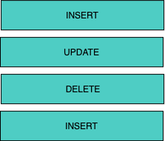
How?
Notes:
As a things happen in SQL Server or any RDBMS what will happen is the result of the change requested INSERT, UPDATE, DELETE, etc. will be processed and saved to a file on disk called a Transaction Log. In Postgres case thats the WAL log and in Mysql case that the Binary Logs.
What attunity will do is instead of querying the tables or any of the runtime data it will as we’ve liked to say “read the exhaust from the database”
Doing so allows attunity replicate to not have an impact on the transactional system as things are happening.

Slide 16
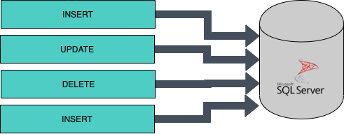
How?
Notes:
As a things happen in SQL Server or any RDBMS what will happen is the result of the change requested INSERT, UPDATE, DELETE, etc. will be processed and saved to a file on disk called a Transaction Log. In Postgres case thats the WAL log and in Mysql case that the Binary Logs.
What attunity will do is instead of querying the tables or any of the runtime data it will as we’ve liked to say “read the exhaust from the database”
Doing so allows attunity replicate to not have an impact on the transactional system as things are happening.

Slide 17
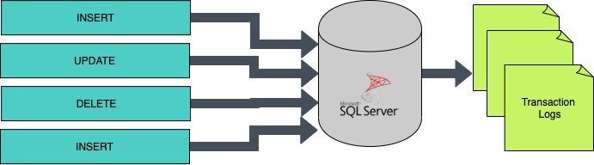
How?
Notes:
As a things happen in SQL Server or any RDBMS what will happen is the result of the change requested INSERT, UPDATE, DELETE, etc. will be processed and saved to a file on disk called a Transaction Log. In Postgres case thats the WAL log and in Mysql case that the Binary Logs.
What attunity will do is instead of querying the tables or any of the runtime data it will as we’ve liked to say “read the exhaust from the database”
Doing so allows attunity replicate to not have an impact on the transactional system as things are happening.

Slide 18
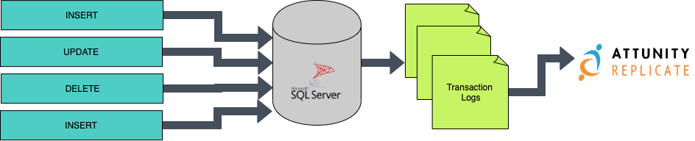
How?
Notes:
As a things happen in SQL Server or any RDBMS what will happen is the result of the change requested INSERT, UPDATE, DELETE, etc. will be processed and saved to a file on disk called a Transaction Log. In Postgres case thats the WAL log and in Mysql case that the Binary Logs.
What attunity will do is instead of querying the tables or any of the runtime data it will as we’ve liked to say “read the exhaust from the database”
Doing so allows attunity replicate to not have an impact on the transactional system as things are happening.

Slide 19

How? Part Deux
Notes:
Once Attunity Replicate has read the transaction logs it can now push that data to different targets.
In our case we used Kafka to store all the events that happened
As well as pushing a direct copy from SQL Server -> Amazon Aurora database for some tables that would provide pretty names for our reporting (pharamcy and policy names for example)
In our case we used Attunity as a simple data mover.
It does have other abilities to filter, transform and do other things but we wanted to keep it as simple as possible

Slide 20
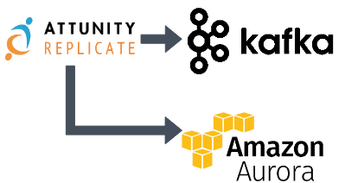
How? Part Deux
Notes:
Once Attunity Replicate has read the transaction logs it can now push that data to different targets.
In our case we used Kafka to store all the events that happened
As well as pushing a direct copy from SQL Server -> Amazon Aurora database for some tables that would provide pretty names for our reporting (pharamcy and policy names for example)
In our case we used Attunity as a simple data mover.
It does have other abilities to filter, transform and do other things but we wanted to keep it as simple as possible

Slide 21
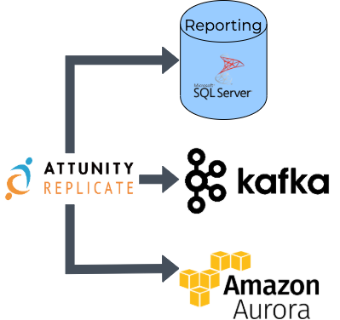
How? Part Deux
Notes:
Once Attunity Replicate has read the transaction logs it can now push that data to different targets.
In our case we used Kafka to store all the events that happened
As well as pushing a direct copy from SQL Server -> Amazon Aurora database for some tables that would provide pretty names for our reporting (pharamcy and policy names for example)
In our case we used Attunity as a simple data mover.
It does have other abilities to filter, transform and do other things but we wanted to keep it as simple as possible

Slide 22
But what’s the catch?
Local development environment support
CPU requirement
Strained CPU? Could run into RDBMS issues
CPU requirement for reading logs
Limited number of tasks
Upgrading versions has been non-trivial
Notes:
Regarding local development it does not support Mac. And since we are a Mac shop that is an issue. And only until recently did they provide a Docker container version.
So we did have to build an Attunity Simulator using a few tools to be able to develop locally and write integration tests.
We are looking at moving to using the dockerized version in the future.
Attunity replicate (at least the version we are on and have been told this may no longer be the case) but it uses SQL server as a middle man to read those transaction logs.
This means that it does have CPU overhead so keep that in mind
When reading online transaction logs which is a rolling window of the most current transtion logs the CPU requirement is very low. But if a task gets behind b/c of a big batch job push a bunch of data and throughput isn’t fast enough or if you had to do maintenance and shut down the task for a few hours. Once it is processing the transaction logs from disk it will impose a much larger CPU overhead until it gets caught back up to the online transaction logs.
First deployment example
We broke the tables out into 43 tasks originally - one task per "important" table, and then batches of 10 tables if they were greater than 2000 rows, and then one final catch-all task. At the time of high CPU usage, we saw that each task was using approximately 2% CPU, so Attunity was using a total of 86% CPU.
During the day load was fine, but once our nightly batch jobs hit it caused attunity to get behind and end up in the boat of reading from the backup transaction logs. This is where the increased sql server CPU load came in and caused problems.

Slide 23
Open Source Alternative

Slide 24
Debezium
An open source distributed platform for change data capture
Can use Change Data Capture to pump data out of MySQL, Postgres or SQL Server into Kafka

Slide 25
Why we didn’t choose it
At the time SQL Server support was in Alpha status
CDC had the potential to cause issues with production
Did not have ability to pump to multiple targets. Would require dev work or finding another tool.
Notes:
Another tool. We do funnily enough still use Debizium as our attunity simulator of sorts locally

Slide 26
It’s still a good option
Great talk by Gunnar Morling around the same event data capture topic and using Debezium to do so
http://bit.ly/2tpFHEF

Slide 27
Kafka

Slide 28
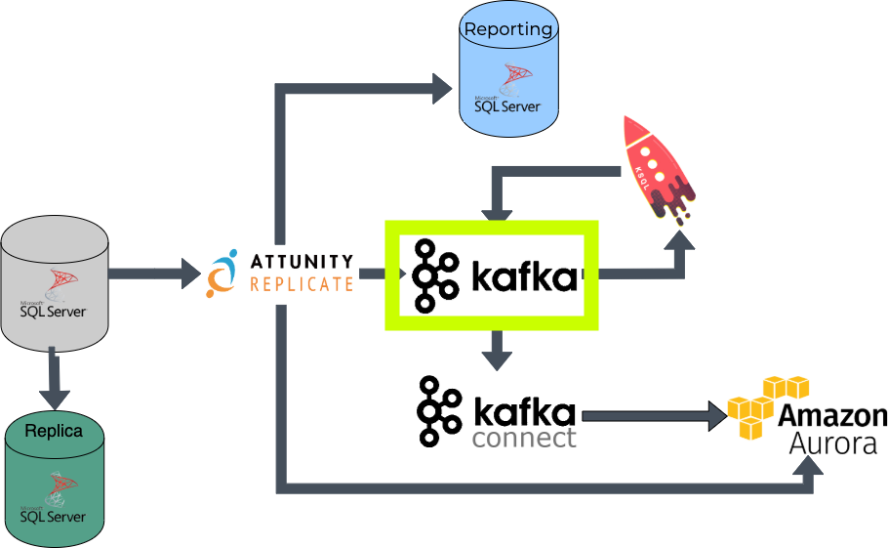

Slide 29
What is it?
Apache Kafka is an open source project for a distributed publish-subscribe messaging system rethought as a distributed commit log. Kafka stores messages in topics that are partitioned and replicated across multiple brokers in a cluster. Producers send messages to topics from which consumers read.

Slide 30
Why?
Battle tested message system
Planned to use this as the messaging system between future microservices
Schema Registry/Avro messages == less disk usage

Slide 31
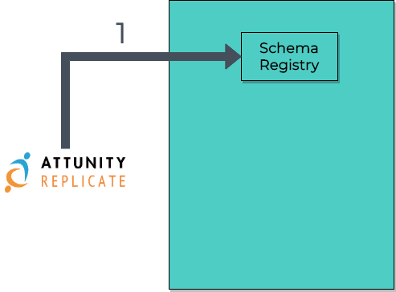
How?
Notes:
So far i have only shown Kafka as being a single entry. That is not entirely true.
Kafka is a distributed system, in our case that is a 3 node cluster.
We also used another Kafka related technology called Schema Registry to be able to easily track schema changes of the underlying message and to save disk space overall.

Slide 32
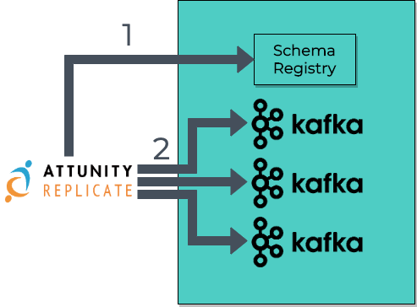
How?
Notes:
So far i have only shown Kafka as being a single entry. That is not entirely true.
Kafka is a distributed system, in our case that is a 3 node cluster.
We also used another Kafka related technology called Schema Registry to be able to easily track schema changes of the underlying message and to save disk space overall.

Slide 33
Schema Registry
Metadata storage
Backed by Kafka
Exposes a REST API to interact with it
Allows for use of Apache Avro binary messages in Kafka
Greatly reduces disk usage

Slide 34
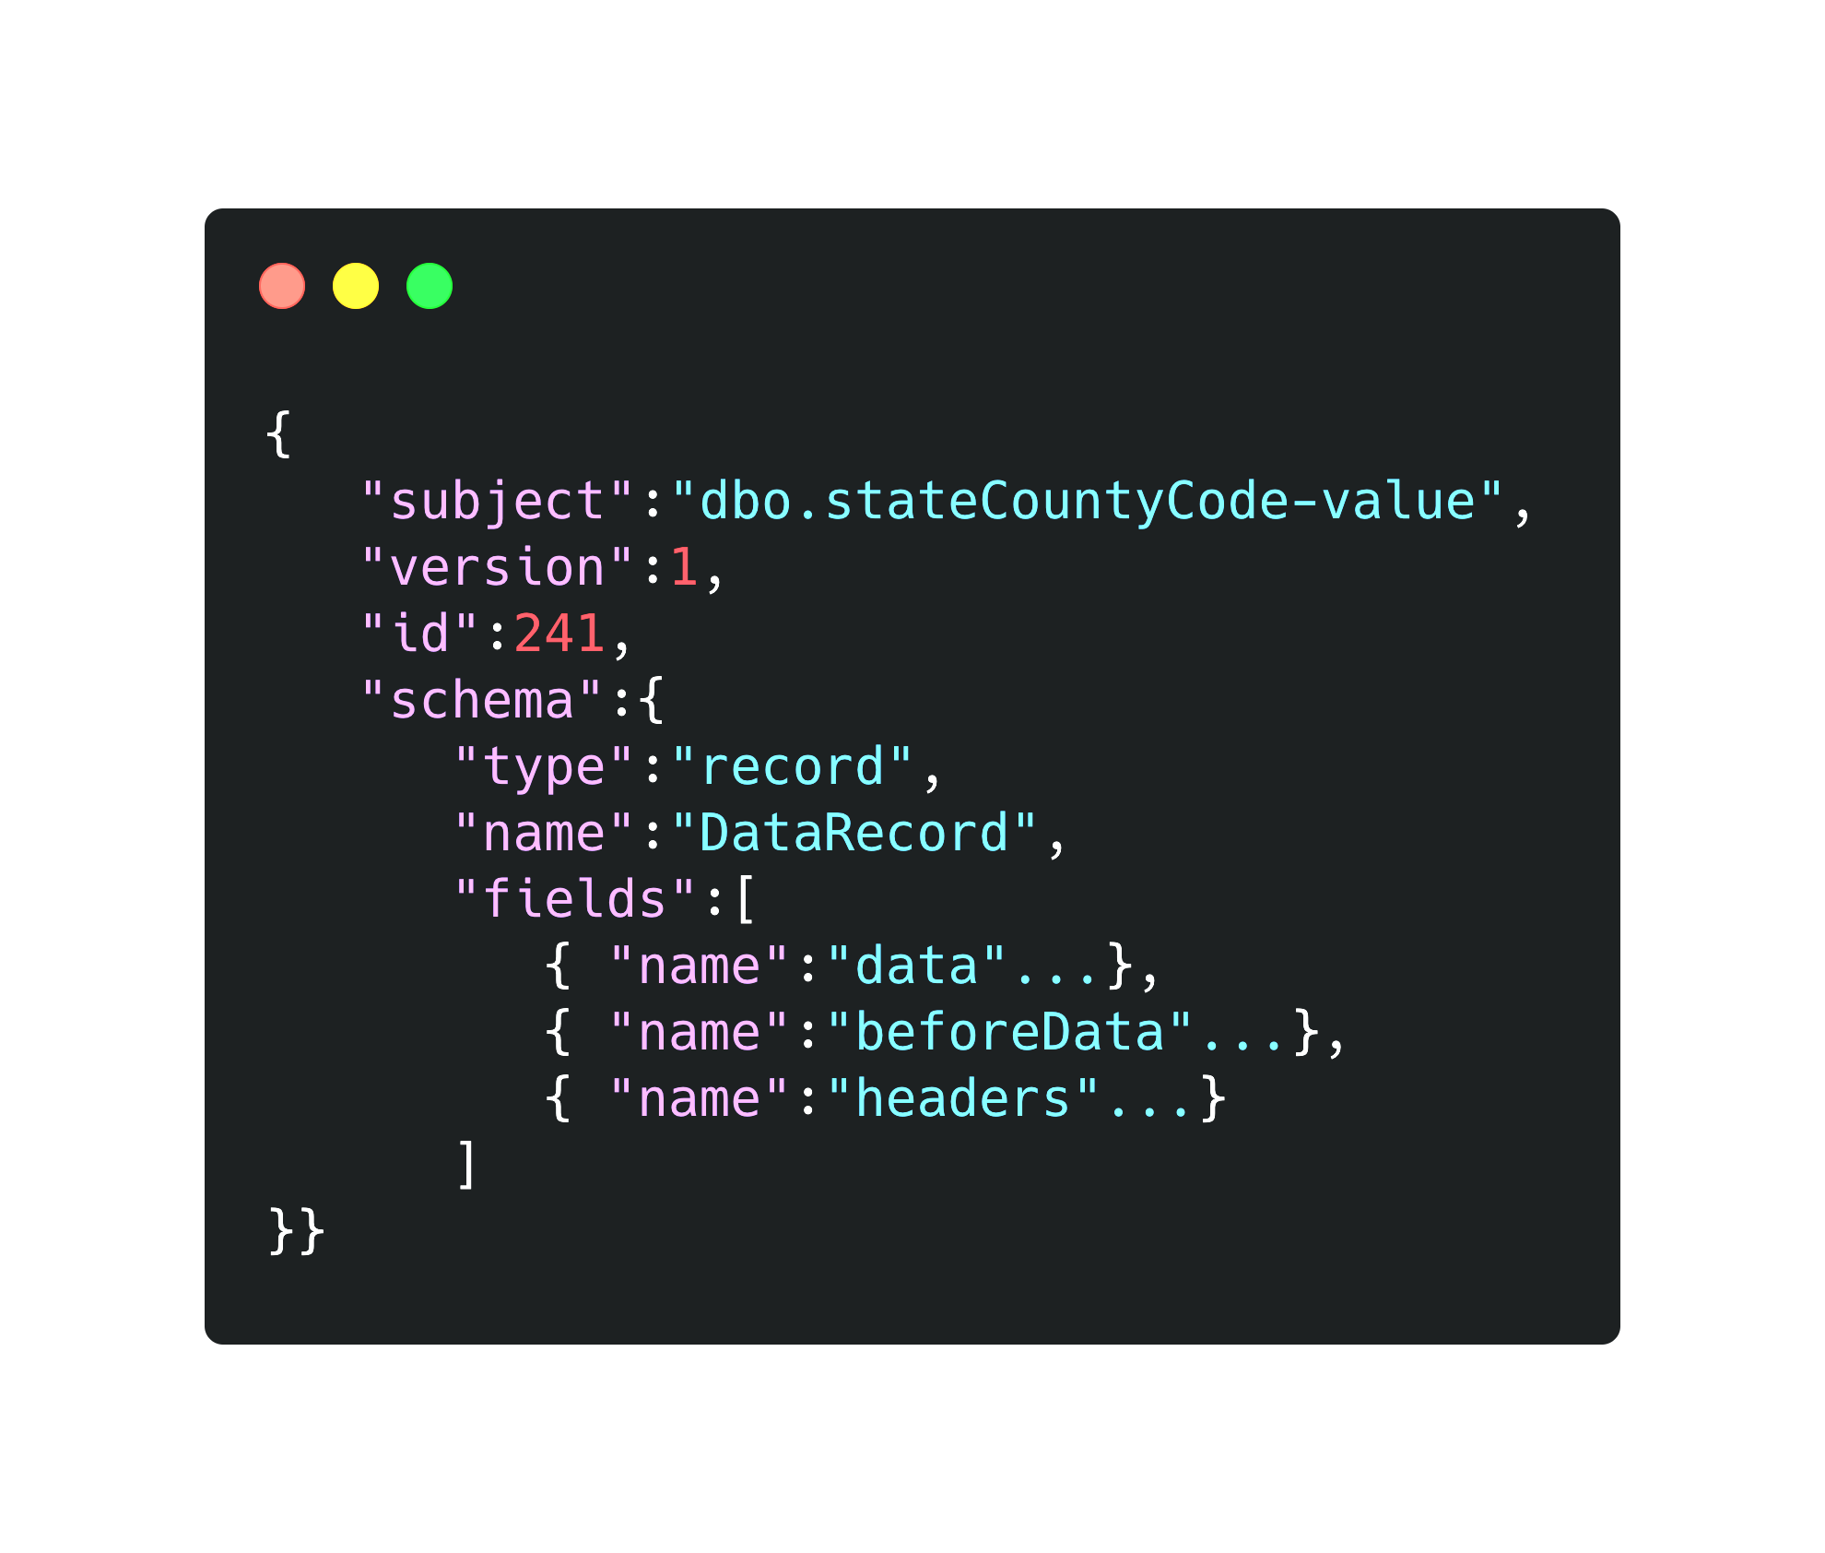
Show me some code (Schema)

Slide 35
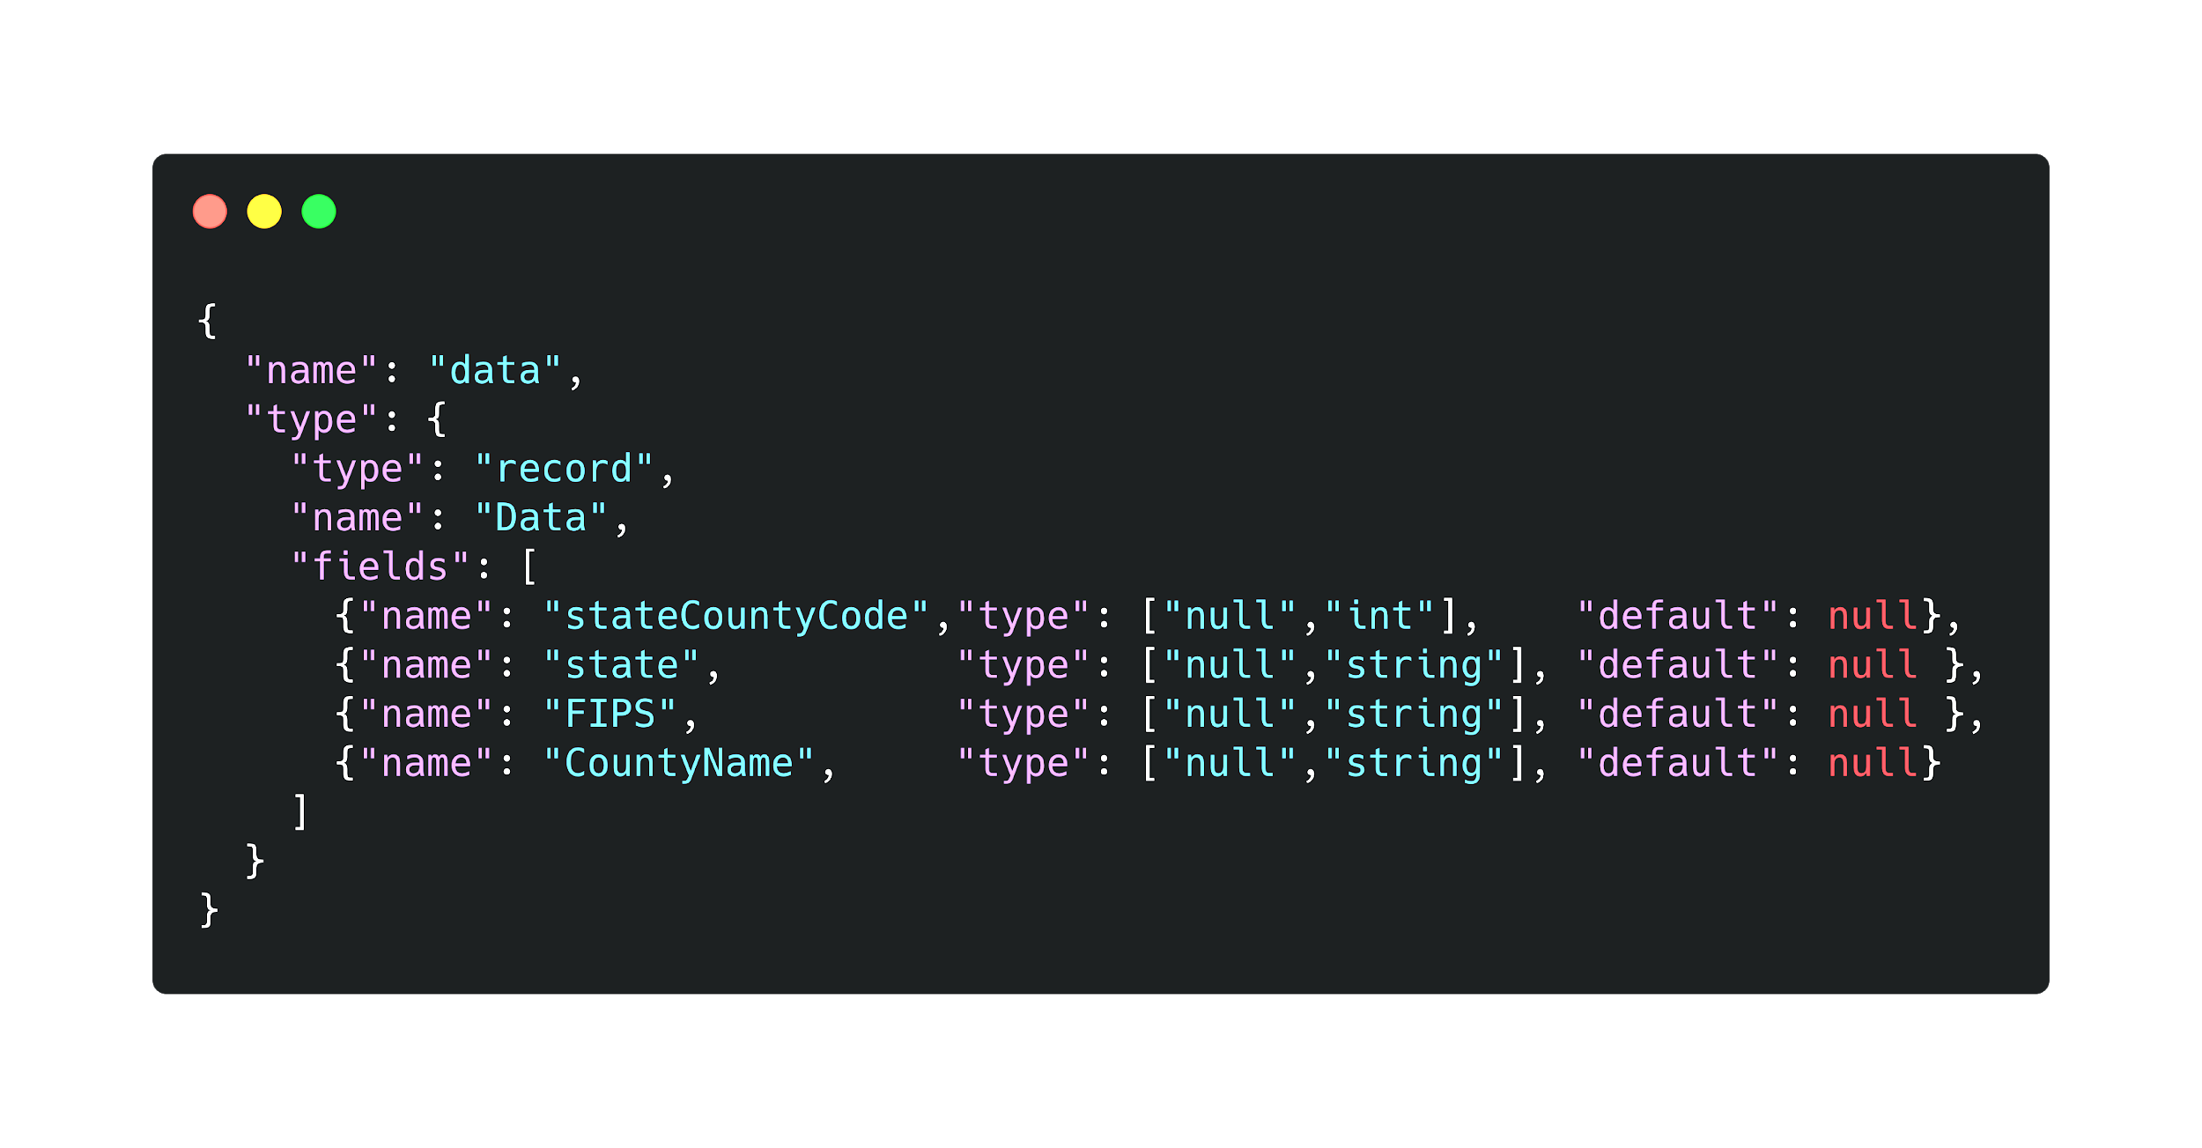
Show me some code (data)

Slide 36
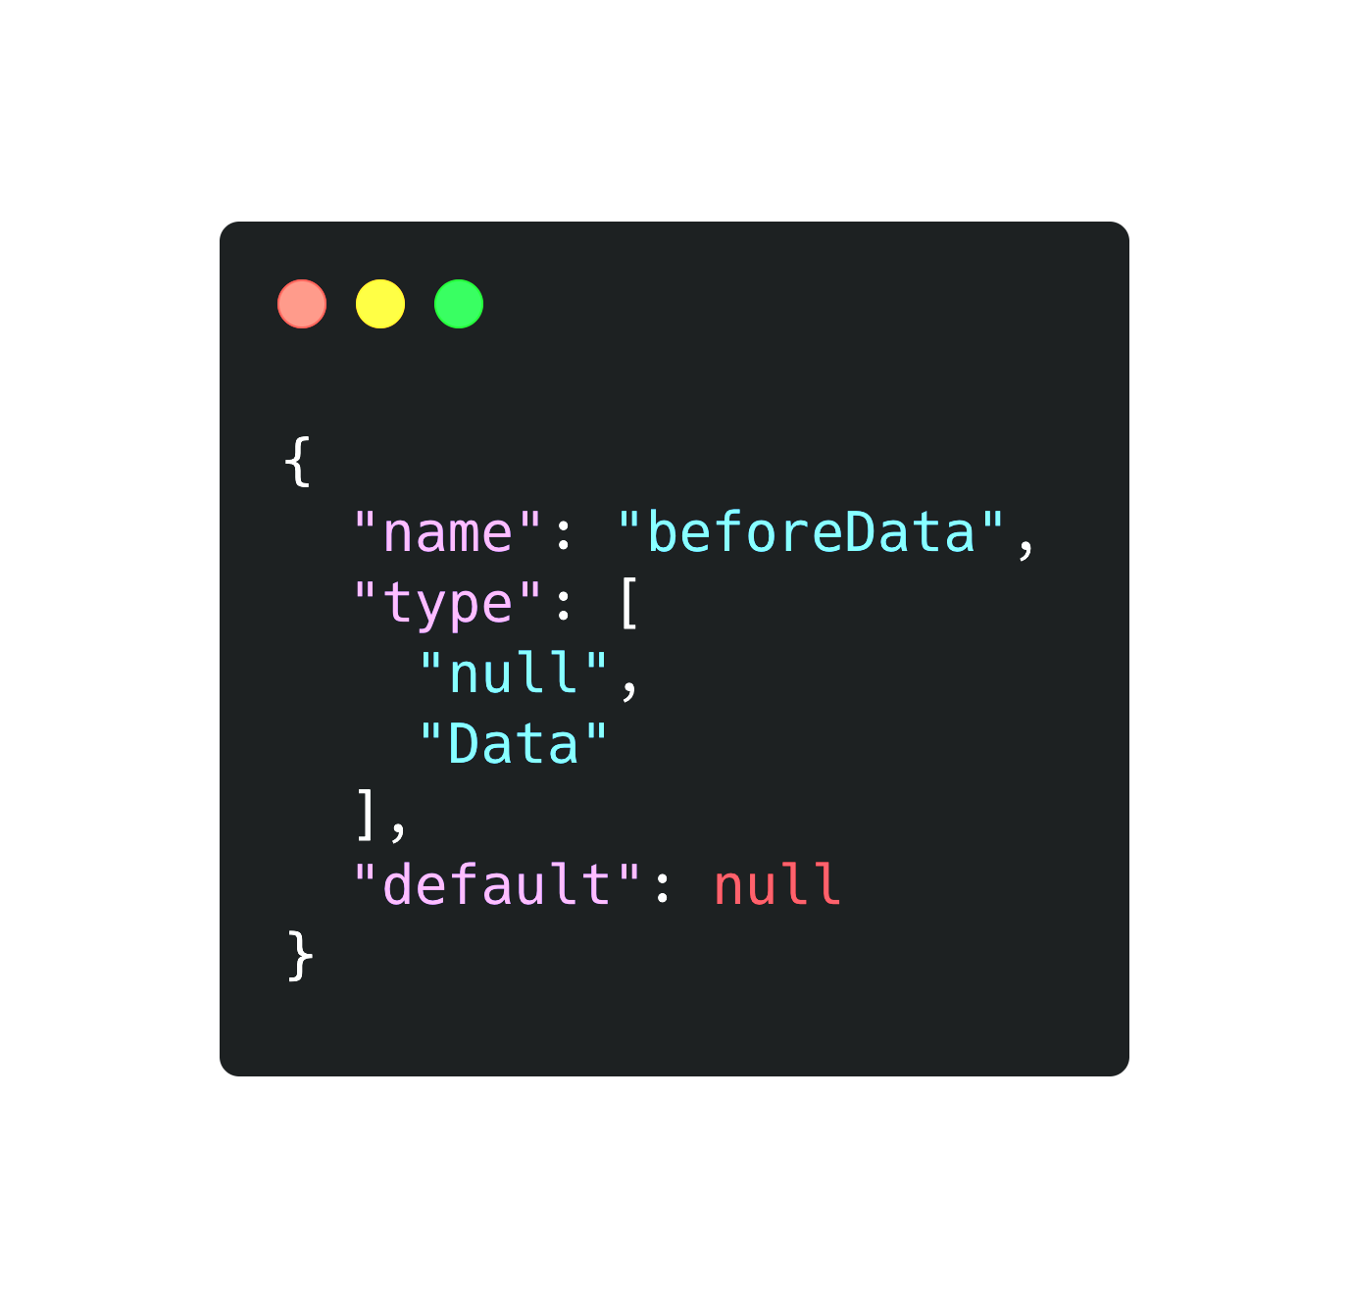
Show me some code (beforeData)

Slide 37
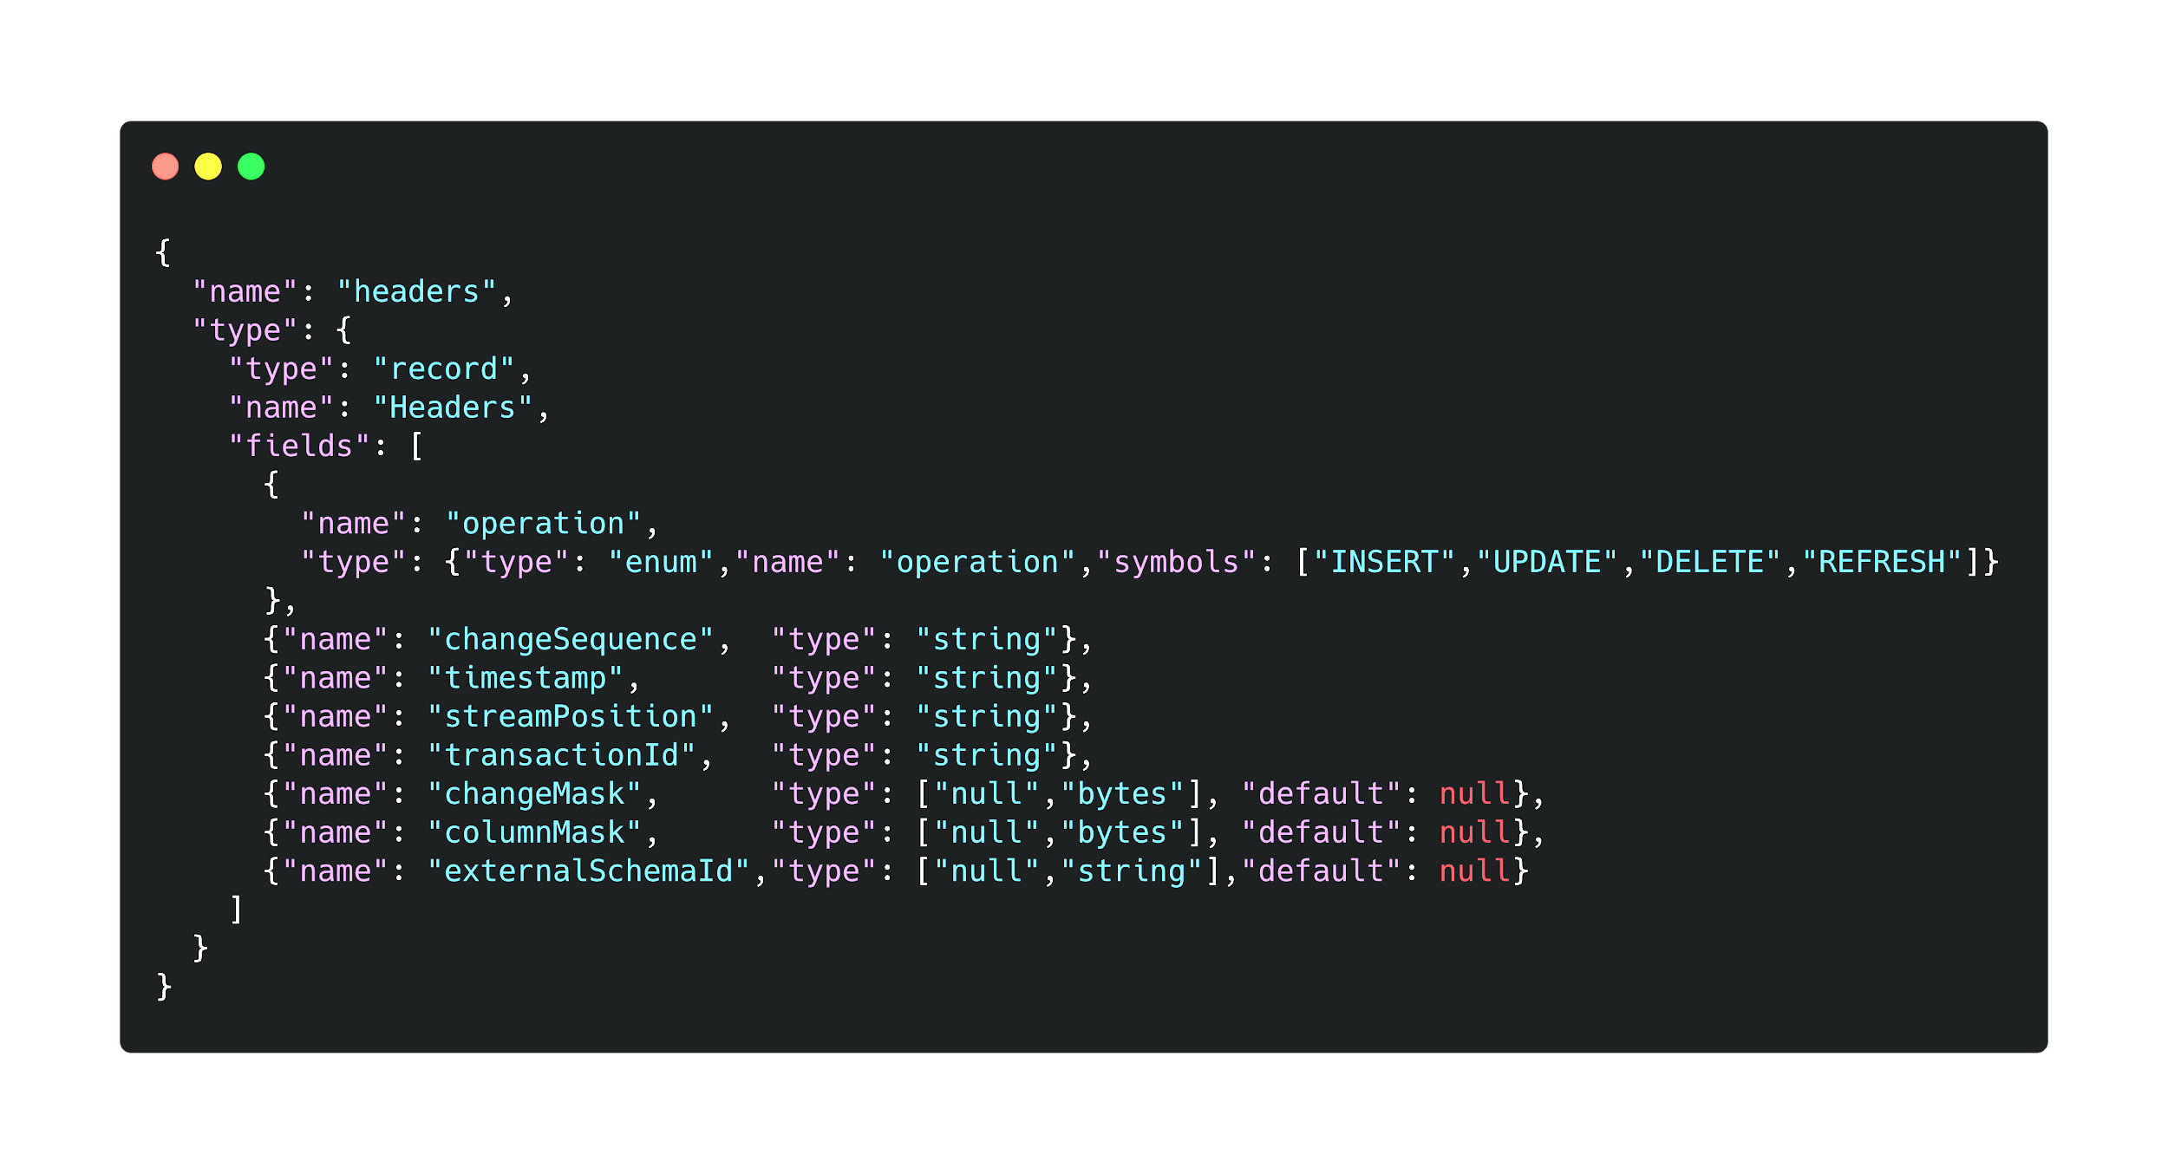
Show me some code (headers)

Slide 38
KSQL

Slide 39
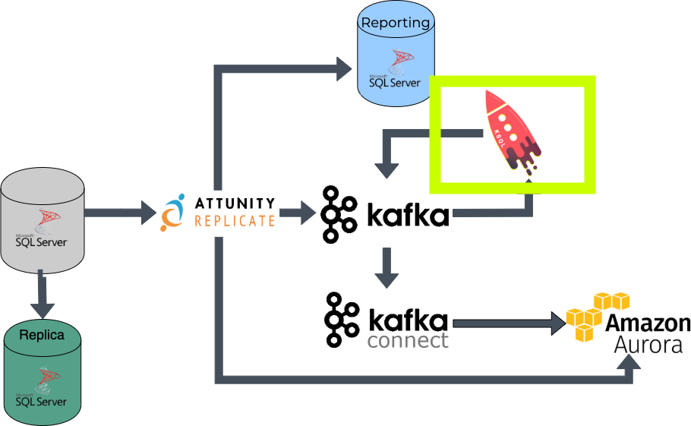

Slide 40
What is it?
Confluent KSQL is the streaming SQL engine that enables real-time data processing against Kafka. It provides an easy-to-use, yet powerful interactive SQL interface for stream processing on Kafka, without the need to write code in a programming language such as Java or Python.

Slide 41
Why?
Easy/familiar SQL interface to Kafka topics
Initial thought was all business logic could live here easily since it was just SQL-like
Allows adhoc & constantly running queries to be executed

Slide 42
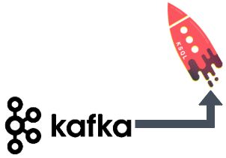
How?

Slide 43
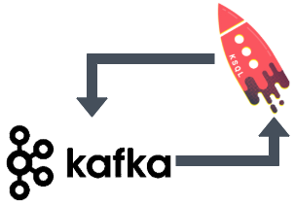
How?

Slide 44
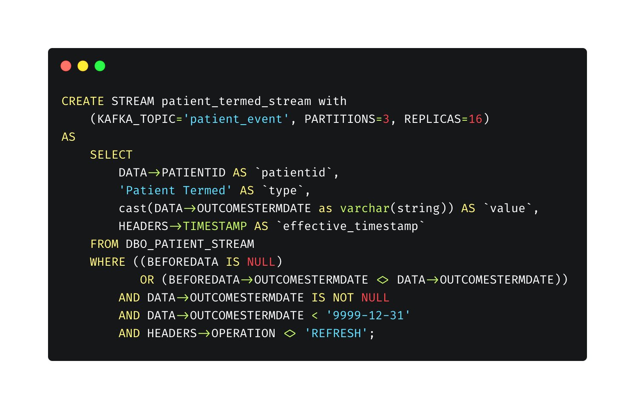
Show me some code

Slide 45
But what's the catch??
KSQL has some rough edges and you will get cut
The deployment model is not great
We did roll our own Flyway adapter to simulate version controlled KSQL streams
Hopefully to be open sourced soon
Adhoc queries can be dangerous 😬
Notes:
Adhoc you could argue the same adhoc queries could be dangerous in an RDBMS as well but in kafka case everything is immutable. So once its written getting it to no longer be there is much more of a task to cleanup/remedy.

Slide 46
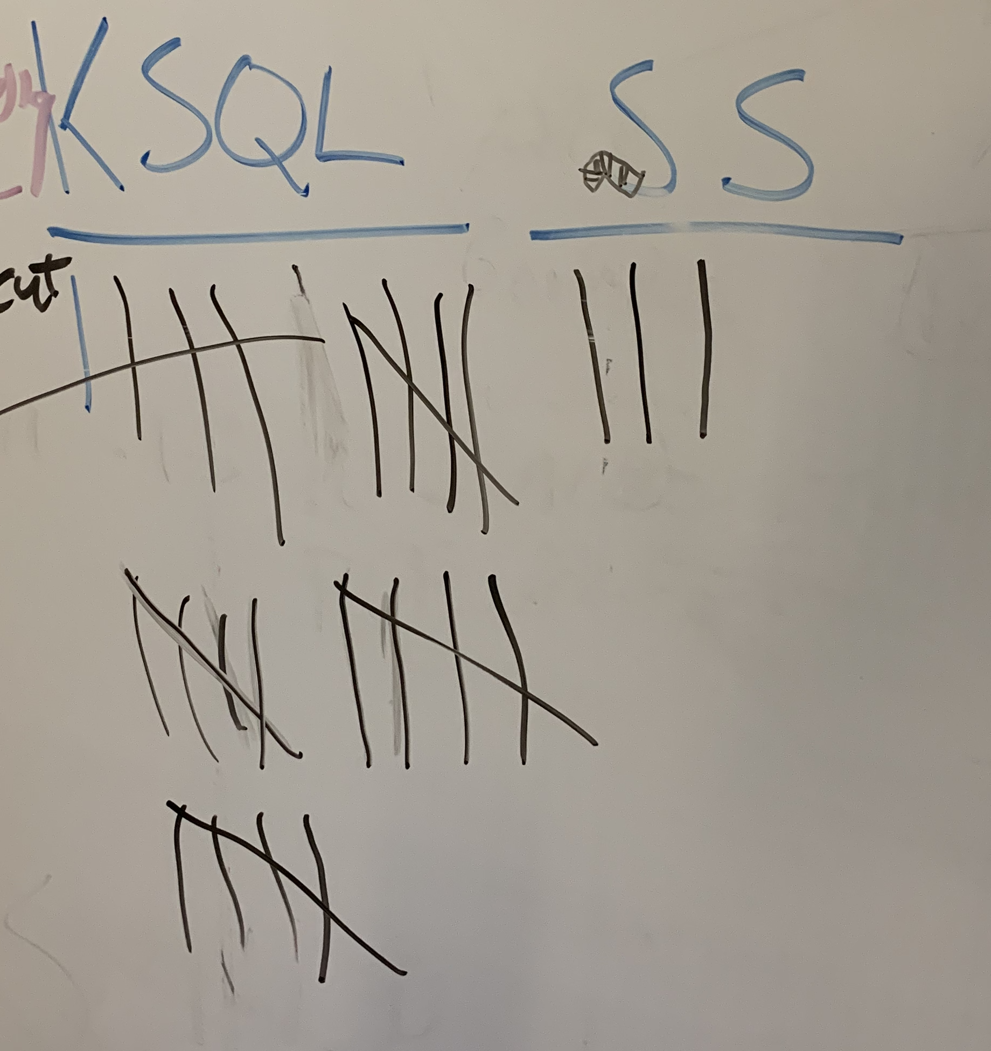
KSQL vs Squid Squad (aka My Team)

Slide 47


Slide 48
Kafka Connect

Slide 49
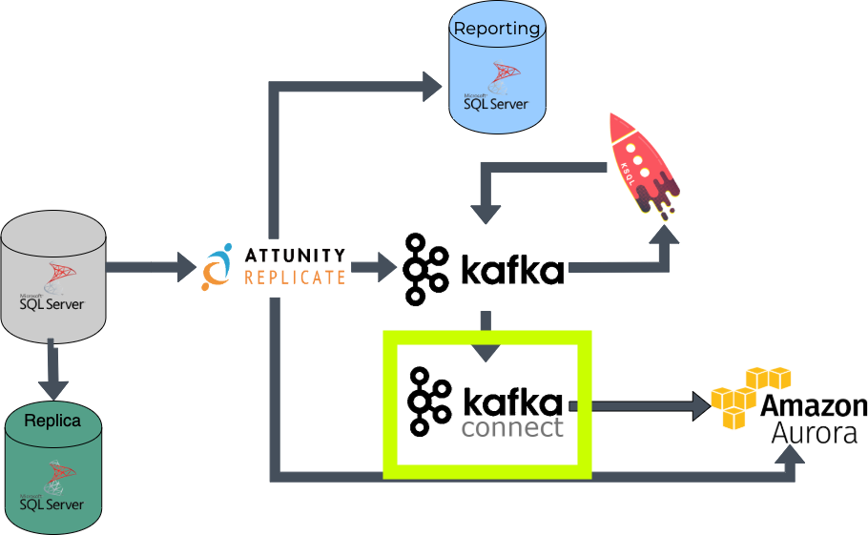

Slide 50
What is it?
Kafka Connect, an open source component of Kafka, is a framework for connecting Kafka with external systems such as databases, key-value stores, search indexes, and file systems.

Slide 51
Why?
De facto standard in getting data in/out of Kafka via configuration only
Analytics reports could not be built by querying Kafka directly so we have to get it out somehow

Slide 52
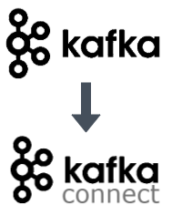
How?

Slide 53
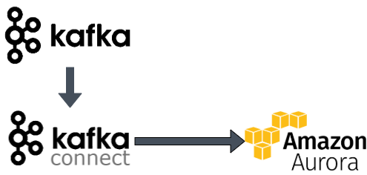
How?

Slide 54
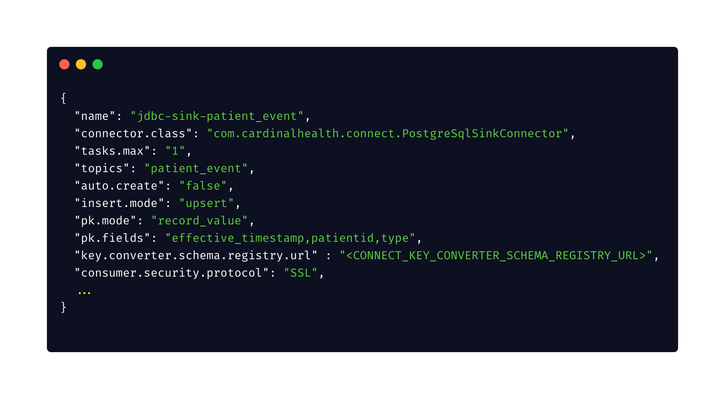
Show me some code
Notes:
Connect.class is custom.
Tasks.max - can spin out multiple threads to increase throughput. - cheap easy way to make sure your single node is fully utlizied before scaling out with more machines.
Auto.create : set to false as we use flyway to manage all database schemas but the option is there to just let it do it.
Insert.mode/pk.fields/pk.mode - how we manage upsert
Since we are using schema registry we have to configure that here as well.

Slide 55
But what's the catch??
Kafka Connect has been pretty solid
Custom connector to fix with some timestamp conversion issues
Warning!!!
offset.retention.minutes will probably bite you at some point
Notes:
Story time : the offset.retention.minutes is not kafka connect specific but this is where we learned about that specific setting. On the version of kafka we were on the default value for this property was 24 hours. So there was a period of time were we had to fix some things and needed Kafka Connect to be turned off. We had it turned off for guess what more than 24 hours. To our surprise when we started it back up it started reprocessing all the events all over again.
In this case it was no big deal b/c it just resulted in upserts happening and the data just stayed the same but we still had to wait until it was complete before processing new events.
In newer versions of Kafka the default has been changed to 7 days for the exact reason above. Enough people hit this scenario and were surprised by the behavior.
But its something to keep in mind.

Slide 56
Show us some numbers

Slide 57
Infra Setup
Schema Registry
m3.xlarge
Kafka Connect Server
PCF 6GB, 4CPU
Aurora cluster
db.r4.4xlarge x 2
1 writer/1 reader
Kafka cluster
m5.large x 3
Attunity Replicate server
m4.xlarge
KSQL Server
PCF 6GB, 4CPU

Slide 58
Real world first End 2 End
~ 400 tables watching for changes
~ 6 months worth of changes
~ 350 million Kafka messages in total processed
Time to do Kafka -> KSQL -> Kafka
~ 4 hours (25k messages per second)
Time to do Kafka -> Kafka Connect -> Aurora
~ 1 hour
~ 30.5 million rows (filtered events)

Slide 59
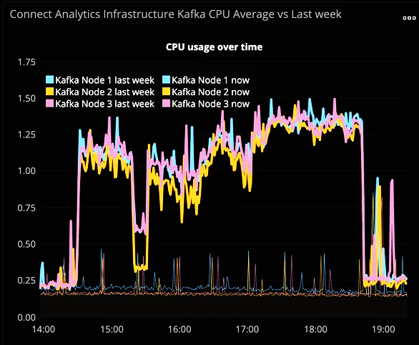
Real world first E2E (Kafka while KSQLing)

Slide 60
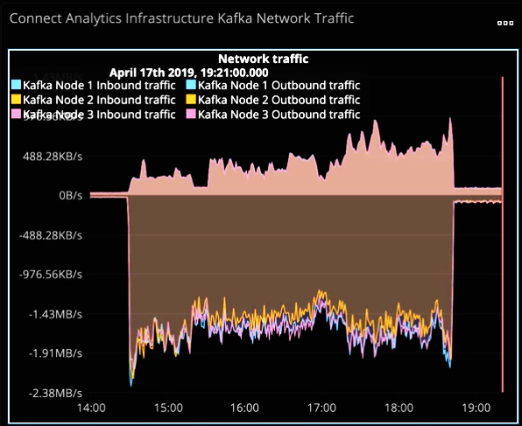
Real world first E2E (Kafka while KSQLing)

Slide 61
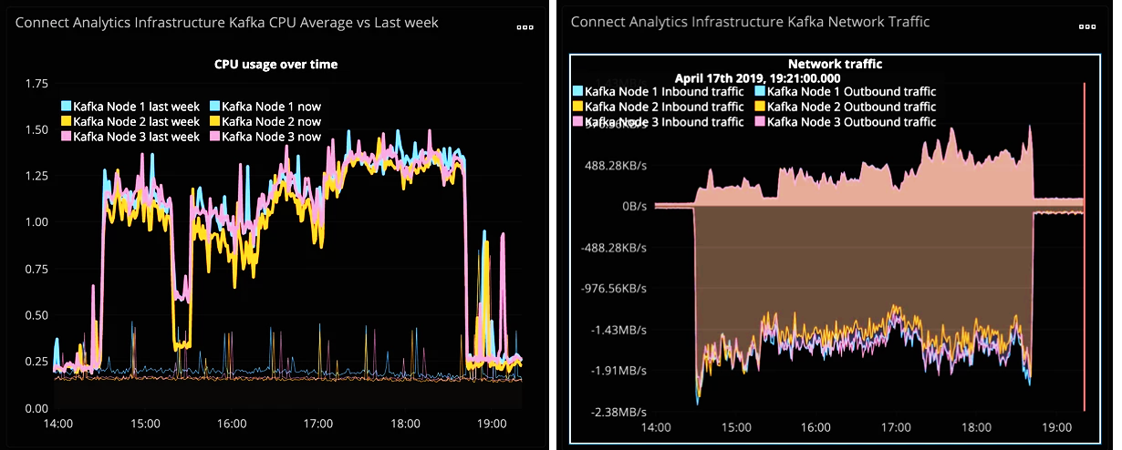
Real world first E2E (Kafka while KSQLing)

Slide 62
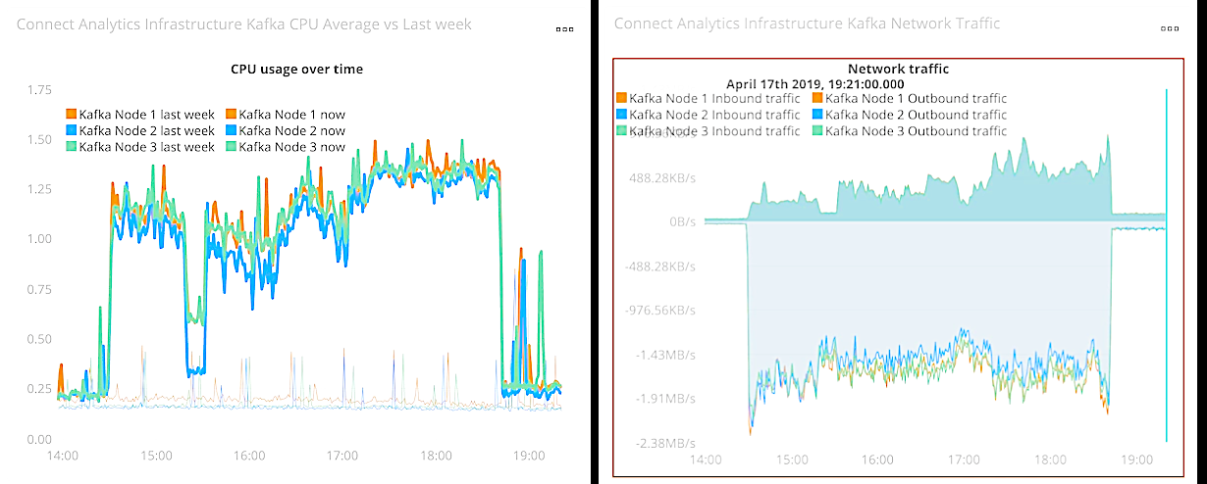
Real world first E2E (Kafka while KSQLing)

Slide 63
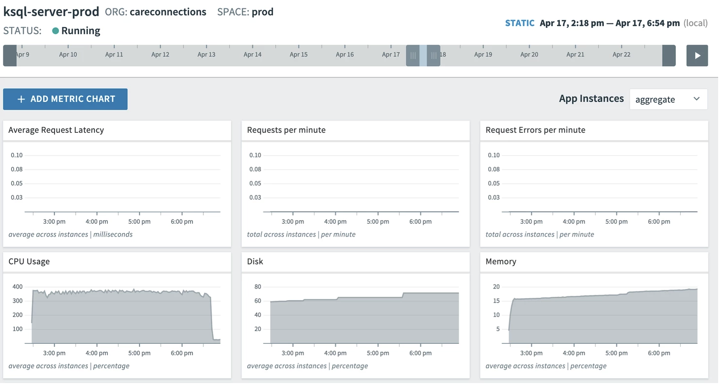
Real world first End 2 End (KSQL)

Slide 64
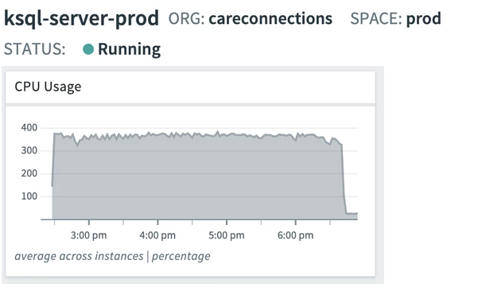
Real world first End 2 End (KSQL)

Slide 65
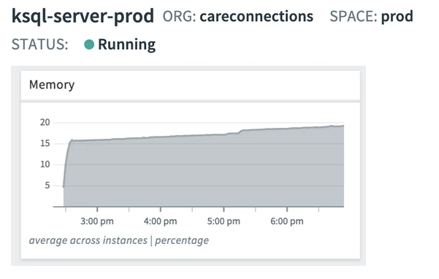
Real world first End 2 End (KSQL)

Slide 66
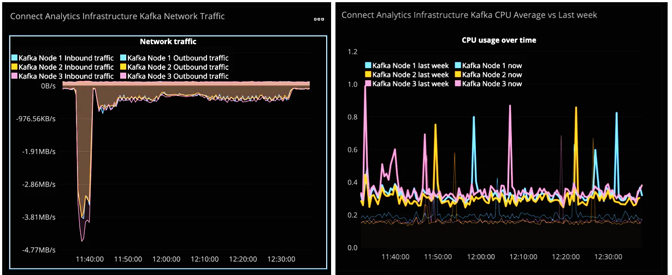
Real world first End 2 End (Kafka Connect)

Slide 67
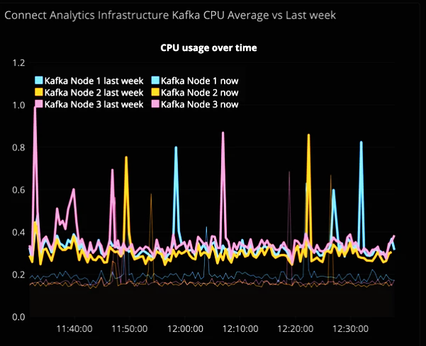
Real world first E2E (Kafka while Kafka Connect)

Slide 68
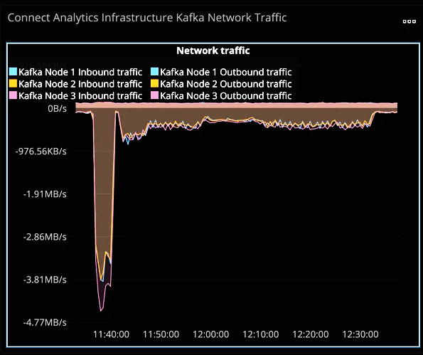
Real world first E2E (Kafka while Kafka Connect)

Slide 69
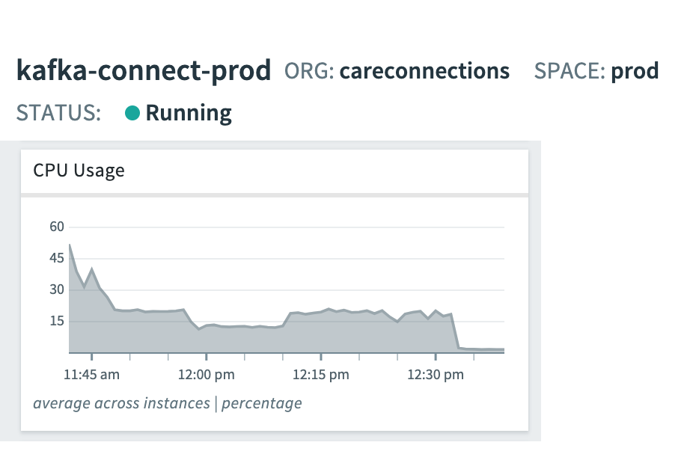
Real world first E2E (Kafka Connect)

Slide 70
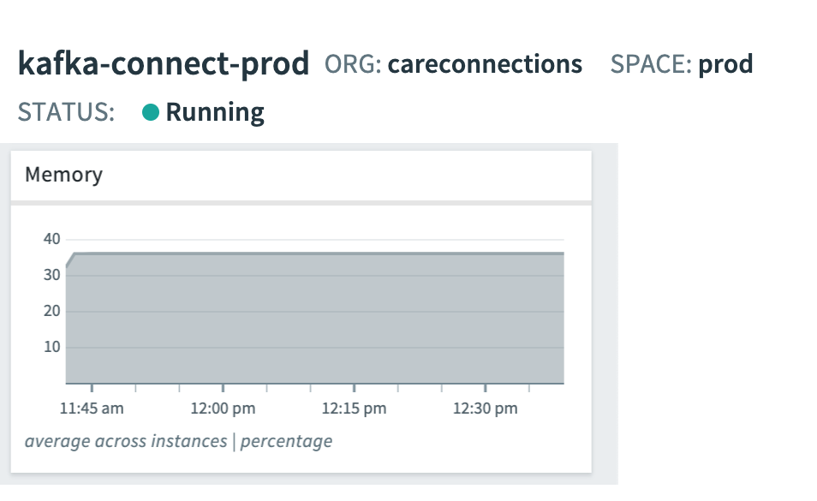
Real world first E2E (Kafka Connect)

Slide 71
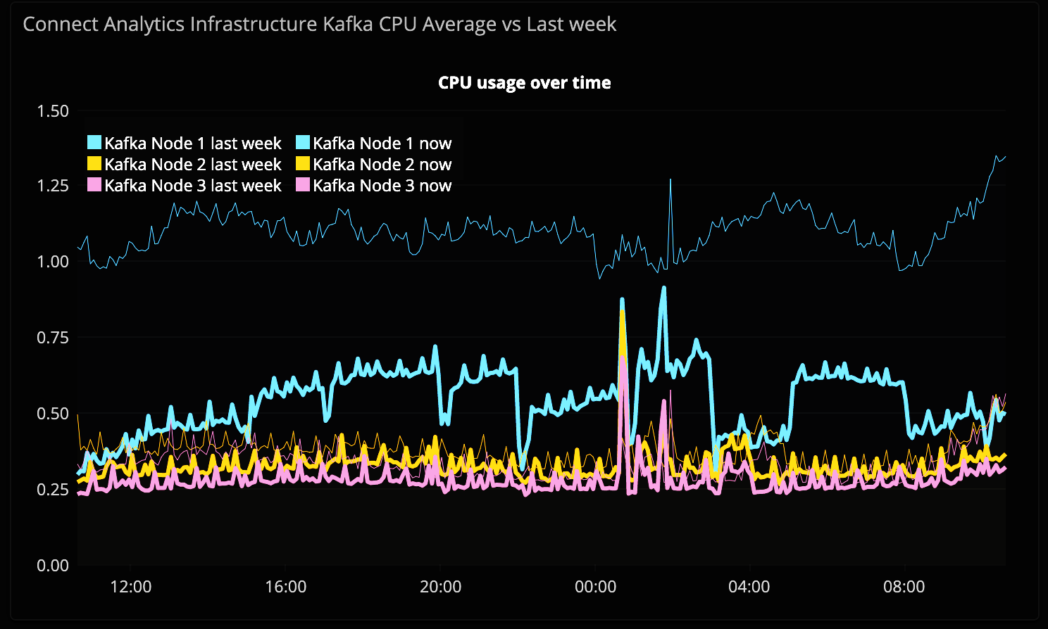
Real world Day to Day (Kafka)

Slide 72
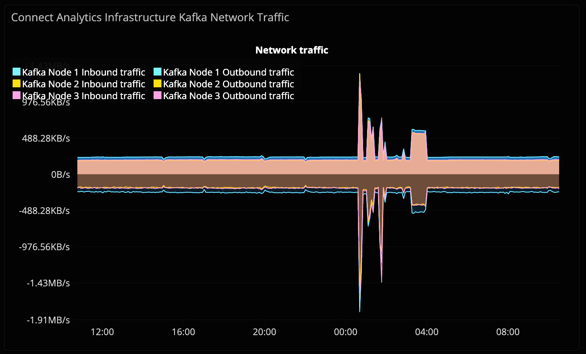
Real world Day to Day (Kafka)

Slide 73
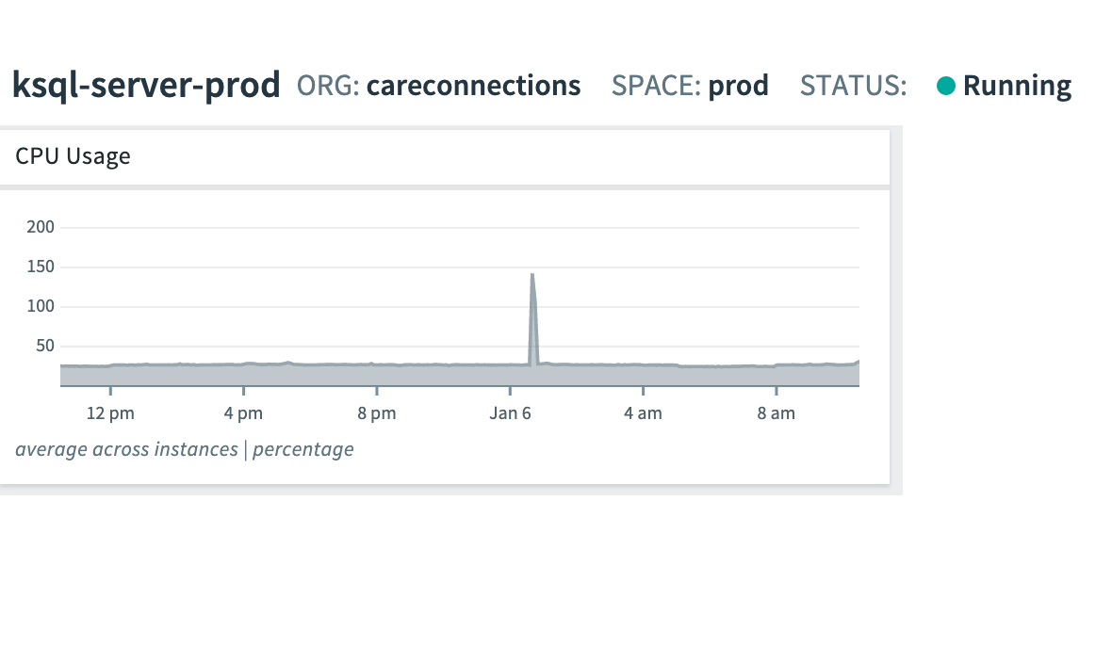
Real world Day to Day (KSQL)

Slide 74
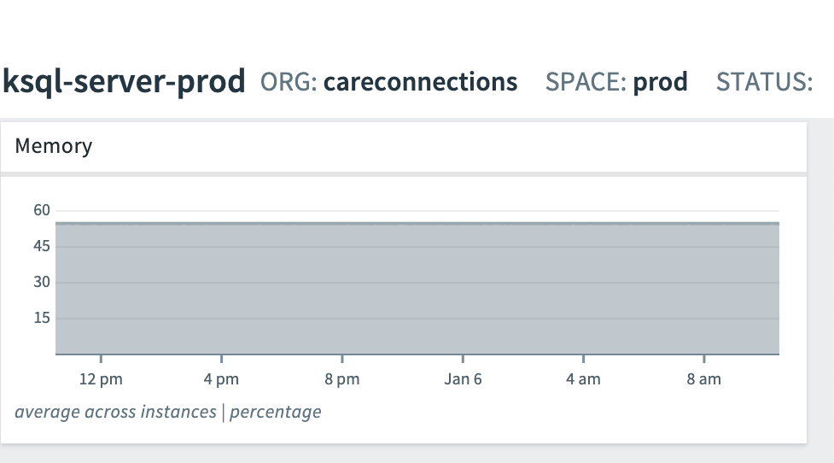
Real world Day to Day (KSQL)

Slide 75
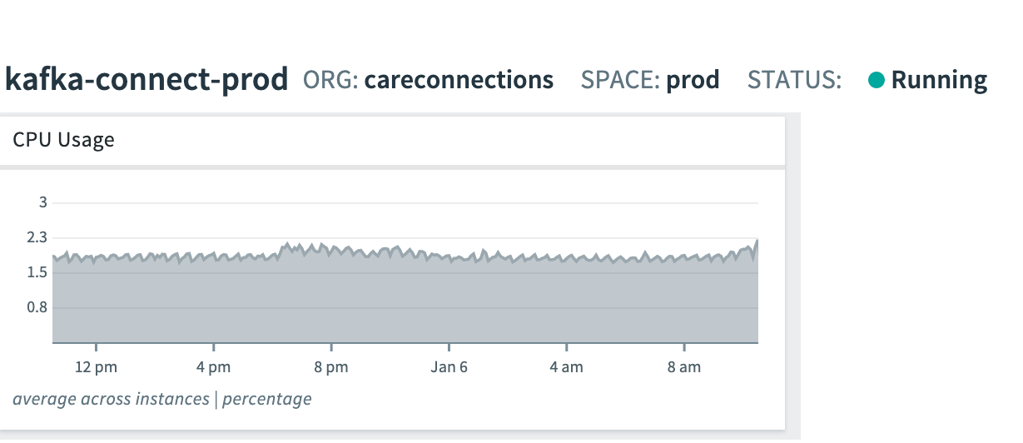
Real world Day to Day (Kafka Connect)

Slide 76
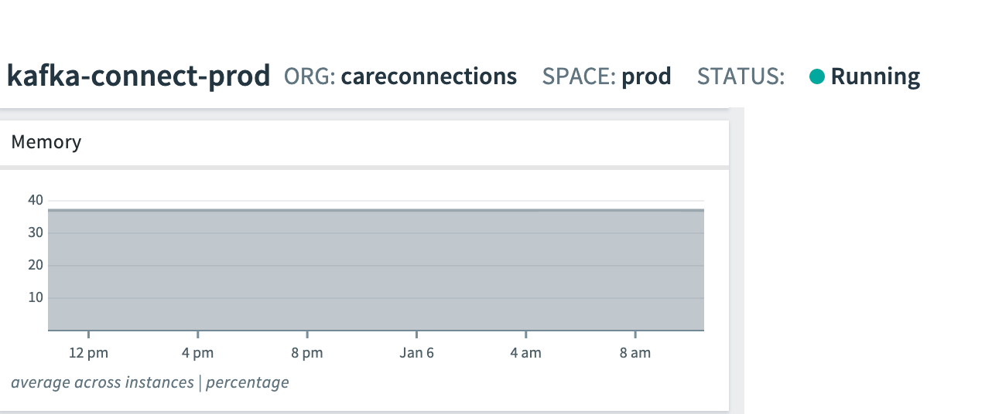
Real world Day to Day (Kafka Connect)

Slide 77
What have we accomplished?

Slide 78
Current State
Delivered our first event based report
Triaged issues that required an audit trail on tables that had no audit trail
Break out one piece from the monolith
Did not bring down production

Slide 79
What’s Next for Us??

Slide 80
The Future
Continue to extract more and more analytics/insights from the events tracking
Continue to use the event data to break the monolith
Explore pushing our biz logic out of Aurora -> KSQL

Slide 81
Helpful Links
Attunity Replicate
https://www.qlik.com/us/products/attunity-replicate
http://bit.ly/2PDmdoz - full support matrix
Kafka
https://kafka.apache.org/quickstart
https://cwiki.apache.org/confluence/display/KAFKA/KIP-186%3A+Increase+offsets+retention+default+to+7+days
KSQL
https://docs.confluent.io/current/ksql/docs/index.html
Schema Registry
https://docs.confluent.io/current/schema-registry/index.html
Kafka Connect
https://docs.confluent.io/current/connect/index.html
Debezium
http://bit.ly/2tpFHEF
https://debezium.io/
Confluent on CDC and Kafka
https://www.confluent.io/blog/no-more-silos-how-to-integrate-your-databases-with-apache-kafka-and-cdc/

Slide 82
Q&A

